Slide 1

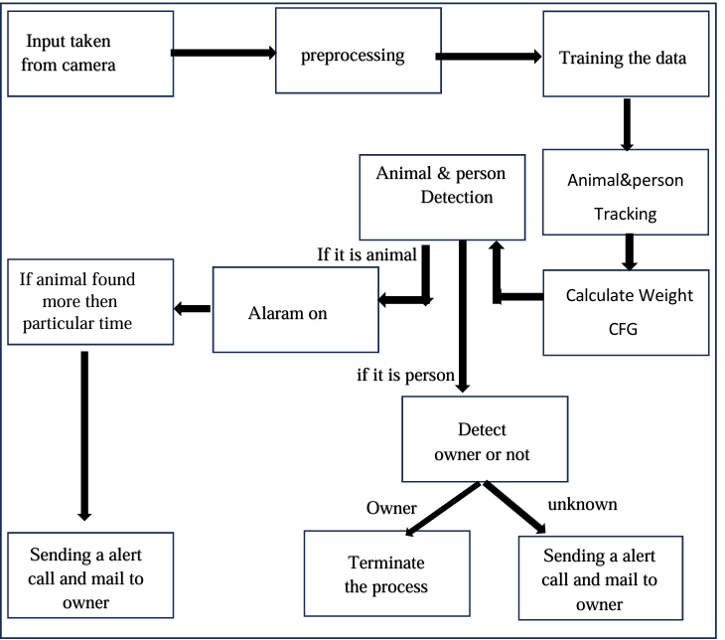
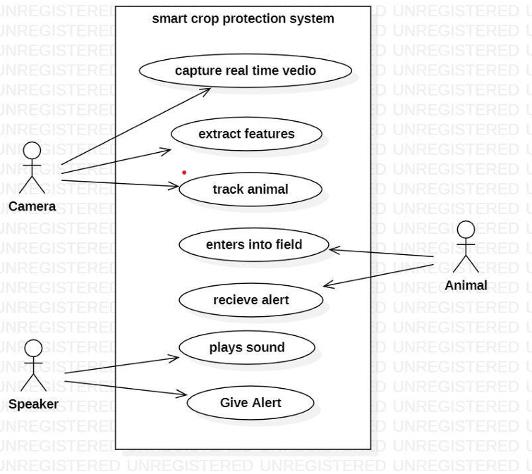
Smart Crop Protection System using Deep Learning
Sreyas Institute of Engineering and Technology
Data Science
MARRI ANIL KUMAR GHATTY LALITHA APOORVA
BONGIRI MANIKANTA
MIDIDODDI DHANRAJ
Abstract
SYSTEM ARCHITECTURE
How Proposed Algorithm Works
Real-Time Video Feed:
The system is constantly recording real time video feed of a camera tracking the crop field.
Frame Processing:
That is why, the captured frames are introduced to the YOLOv3 algorithm for the subsequent analysis. Compared with Fast R-CNN that takes multiple passes over the image, YOLO achieves object detection in real time.
Grid Division:
YOLO divides the image into an S×S grid, To achieve this YOLO splits the picture into 823530 S×S rectangles. In each cell of the grid, regression of bounding boxes and classification of class probabilities for objects with center in that cell are done.
Bounding Box Prediction:
In particular, for each grid cell YOLO assigns a fixed number of bounding boxes.
Each bounding box includes:
Coordinates: Center coordinates (x,y) and width (w) and height (h).
Confidence Score: Shows the probability that the box contains an object, how accurate a box the model is.
Class Probability Prediction:
Each grid cell they also compute the class probabilities of new objects as well. These probabilities tell us the probability of the given classes, for example, animal, person and so on.
Object Detection:
The resulting frames contain rectangular outlines drawn around animals or intruders detected (depending on the network used) marked with their class and respective confidence levels.
Real-Time Alerts:
When the system detects an unknown person or animal with a confidence score above a predefined threshold, it triggers the alert mechanisms: Sound Playback: To scare away the intruder. Email Notification: The farmer is notified through an email containing a picture of the captured object.
Phone Call Alert: I
f the threat is still active after 15 minutes then a call is automatically placed to the farmer.
Logging and Monitoring:
Every triggering event is documented and includes the object type detected, time when the detection was made and the actions that followed. This leads to capability to watch and analyze intrusions over a time space.
Advantages Associated with Employing YOLO on our Project
1.Speed: Due to the latter usage of the architectural components of YOLO, the identified threats can be processed in real-time.
2.Accuracy: It reduces false positives by making sure that alerts distance itself from false negative detections whilst YOLO has high accuracy that makes it identify multiple objects accurately.
3.Scalability: This means that the system can be loaded on edge devices and used in the different contexts of agriculture
Email & Phone Alert System:
For alerts, the system uses a combination of email notifications and phone calls: Email Notifications: The system employs SMTP for alerting the farmers via an email with an image of the object that has been detected for assessment.
Phone Call Alerts: To achieve this the system
Existing Drawbacks
Fences causes damage to human also
Electric fences are dangerous to animals
Arranging fences is consumes more power
Construction takes more time
Fences occupies more place for construction
Agriterrorism with regard to animal damage greatly affects the crop yield for farmers, resulting to some of them recording large losses. Farm animals like buffaloes, cows, goats and birds trespass in the fields trample the crops and this can only be destructive for farmers since they cannot constantly protect their shambas. Measures such as the use of barriers, wire fences, or personnel vigilance yields most of the time insufficient results. In addition to scarecrows, which enemies can easily bypass with many animals, farmers also employ human effigies. To control these problems, we introduce an AI-based Scarecrow system using video processing in real time for crop protection from wildlife. The system uses a camera to record videos and analyzes them with YOLOv3, an object detection model together with OpenCV and the COCO names database. If any animal or bird is identified, then the system produces a sound alerting the animal not to invade the compound Moreover, if an animal has been sensed for more than one minute consecutively, the system will alert the farmer sending him/her an e mail and dialing the farmer`s phone number..
KEYWORDS: Webcam, Image acquisition module, Animal detection, Animal Tracking, Calculate Weight CFG, Animal Detection
Advantages
* Efficient detection
* Proactive deterrence
* Real-time monitoring
* Cost-effective
* Scalable
* Environmentally friendly
* Reduced labor dependency
* Enhanced food security
Image Acquisition:
The process begins when an individual places their finger on a scanning device or sensor.
Near-infrared (NIR) light sources emit light onto the finger's surface. Hemoglobin in the veins absorbs some of this light, causing the veins to appear as darker patterns against a lighter background.
Specialized cameras equipped with NIR sensors capture the reflected light, creating a digital image that highlights the finger's vein patterns.
Applications of the Smart Crop Protection System using Deep Learning
Wildlife Intrusion Detection
Real-time monitoring and detection of animals encroaching on farmland.
Prevents crop damage by alerting farmers instantly.
Sustainable Farming Practices
Reduces the need for physical barriers like fences, ensuring cost-effective crop protection.
Promotes coexistence with wildlife by preventing harm to animals.
Labor Optimization
Automates farm surveillance, reducing the need for manual monitoring.
Saves time and resources for farmers.
Environmental Conservation
Avoids the use of harmful methods such as traps or chemical deterrents.
Protects ecosystems by using non-invasive techniques to deter animals.
Smart Farming Integration
Can be integrated into IoT-based smart farming systems for centralized monitoring.
Enhances overall farm management by combining animal detection with other technologies like weather monitoring and irrigation systems.
Disaster Prevention
Prevents large-scale losses during critical growth phases by detecting and acting promptly on wildlife intrusions.
Educational and Research Tools
Offers a platform for studying animal behavior patterns and their interaction with farmlands.
Provides data for ecological and agricultural research.
System Workflow
Introduction
The system's workflow can be summarized as follows:
1. Video Feed Acquisition:
The webcam continuously captures live video feeds from the farmland and sends them to the computer for processing.
2. Object Detection:
The object detection software analyzes the video feed, leveraging the YOLOv3 model and the COCO dataset to identify and classify animals and birds.
3. Animal Tracking:
Detected objects are tracked in real-time to monitor their movements and activities within the field of view.
4. Audio Deterrence:
When an intruding animal is detected and tracked, the audio generation software is activated. It generates and plays an audio deterrence sound. 5. Real-Time Monitoring: The entire process is executed in real-time, allowing the system to continuously monitor the farmland and provide immediate deterrence when needed.
Agriculture faces ongoing challenges from animal invasions and trespassers, leading to significant crop damage and economic loss. In order to ensure the safety and protection of crops, the farming industry requires innovative solutions that are efficient, reliable, and proactive. The goal of this project is to explore and apply the game-changing possibilities of AI technology to address these challenges. Traditional crop protection methods often rely on manual monitoring or mechanical deterrents, which can be inefficient, prone to errors, and lack scalability. These methods not only require intensive labor but also fail to provide real-time, automated responses to threats, leaving crops vulnerable to damage and reducing the farmer’s ability to maximize output and maintain security. To address these challenges, the project utilizes AI-powered surveillance systems, leveraging computer vision and machine learning technologies to automate the detection of threats in real-time. Using a combination of YOLO (You Only Look Once) object detection algorithms and OpenCV, the system is capable of identifying animals or intruders entering the field. protection. First, the system’s ability to automatically detect and classify intrusions ensures real-time various types of threats, ensuring that actions are taken only when necessary. Third, the system integrates with smart alert mechanisms like sound playback, email notifications, and phone alerts, ensuring that farmers are notified instantly and can take appropriate action without being physically present in the field. Finally, the integration of camera-based monitoring allows for the capture of visual evidence, which can be shared with farmers to enhance understanding and trust. This project aims to revolutionize crop protection by providing a more advanced, automated, and reliable approach using AI technology. By implementing real-time monitoring, smart alerts, and efficient detection mechanisms, the system not only reduces manual labour but also minimizes the risk of crop loss, leading to enhanced productivity and farmer security.
.
CONCLUSION
In conclusion, the persistent problem of crop damage by wild animals in South India presents a complex challenge, but the proposed module offers a multifaceted and holistic approach to address it. The module's diverse components, including deterrents, fencing, wildlife corridors, and farm guarding practices, emphasize the importance of adaptability to different contexts and species-specific behaviors. Moreover, the integration of early warning systems and modern technology enhances the timeliness and efficiency of responses to potential threats.Community collaboration and government support are integral to the success of these measures, as the burden of solving this issue cannot rest solely on farmers' shoulders. Encouraging knowledge- sharing and cooperation within the farming community is essential, as it empowers individuals to adopt best practices and collectively protect their crops. Additionally, government support through financial assistance and the establishment of wildlife management programs demonstrates a commitment to rural livelihoods and wildlife conservation.Education and research are pivotal components, as informed farmers can make more effective decisions regarding wildlife management conservation
Under The Guidence of
Dr . K .Rohit Kumar
Dr. G. Naga Rama Devi
Under The Guidance of Dr . K .Rohit Kumar, G. Naga Rama Devi ,G. JYOTHI

